Slide 1
Accounting Principles
Thirteenth Edition
Weygandt ● Kimmel ● Kieso
Chapter 19
Managerial Accounting
This slide deck contains animations. Please disable animations if they cause issues with your device.

Slide 2
Chapter Outline
Learning Objectives
L O 1 Identify the features of managerial accounting and the functions of management.
L O 2 Describe the classes of manufacturing costs and the differences between product and period costs.
L O 3 Demonstrate how to compute cost of goods manufactured and prepare financial statements for a manufacturer.
L O 4 Discuss trends in managerial accounting.

Slide 3
Managerial Accounting Basics
Provides economic and financial information for managers and other internal users.
Comparing Managerial and Financial Accounting
Similarities and differences:
Each field deals with economic events of a business
Both require that economic events be quantified and communicated to interested parties

Slide 4
Comparing Managerial and Financial
Feature | Financial Accounting | Managerial Accounting
Primary Users of Reports | External users: stockholders, creditors, and regulators. | Internal users: officers and managers.
Types and Frequency of Reports | Financial statements. Quarterly and annually. | Internal reports. As frequently as needed.
Purpose of Reports | General-purpose. | Special-purpose for specific decisions.
Content of Reports | Pertains to business as a whole. Highly aggregated (condensed). Limited to double-entry accounting and cost data. Generally accepted accounting principles. | Pertains to subunits of the business. Very detailed. Extends beyond double-entry accounting to any relevant data. Evaluated based on relevance to decisions.
Verification Process | Audited by C P A. | No independent audits.

Slide 5
Management Functions
Planning
Maximize short-term profit and market share
Commit to environmental protection and social programs
Add value to the business
Directing
Coordinate diverse activities and human resources
Implement planned objectives
Provide incentives to motivate employees
Hire and train employees
Produce a smooth-running operation
Controlling
Keeping activities on track
Determine whether goals are met
Decide what changes needed to get back on track
May use an informal or formal system of evaluations

Slide 6
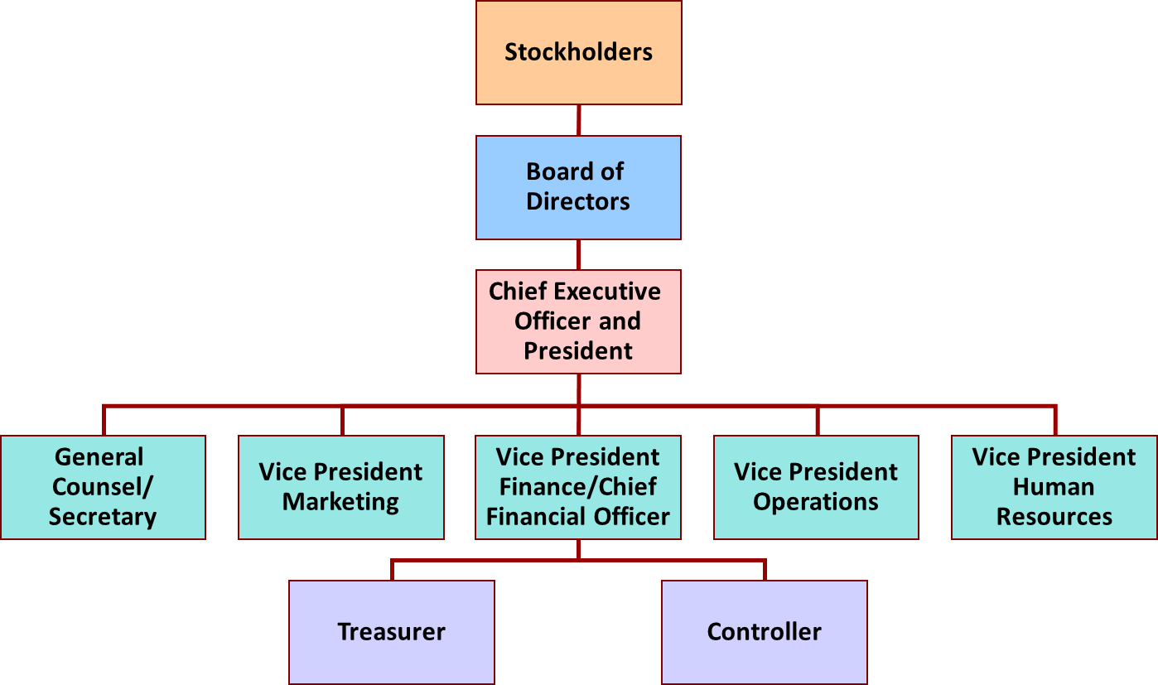
Organizational Structure
Organization charts show the interrelationships of activities and the delegation of authority and responsibility within the company.

Slide 7
Do It! 1: Managerial Accounting (1 of 4)
Indicate whether the following statements are true or false. If false, explain why.
_______ 1. Managerial accountants have a single role within an organization: collecting and reporting costs to management.
_______ 2. Financial accounting reports are general-purpose and intended for external users.
_______ 3. Managerial accounting reports are special-purpose and issued as frequently as needed.

Slide 8
Do It! 1: Managerial Accounting (2 of 4)
Indicate whether the following statements are true or false. If false, explain why.
False. Managerial accountants do determine product costs, but they are also responsible for evaluating how well the company employs its resources. As a result, when the company makes critical strategic decisions, managerial accountants serve as team members alongside personnel from production, marketing, and engineering.
True.
True.

Slide 9
Do It! 1: Managerial Accounting (3 of 4)
Indicate whether the following statements are true or false. If false, explain why.
______ 4. Managers’ activities and responsibilities can be classified into three broad functions: cost accounting, budgeting, and internal control.
______ 5. Managerial accounting reports must now comply with generally accepted accounting principles (G A A P).

Slide 10
Do It! 1: Managerial Accounting (4 of 4)
Indicate whether the following statements are true or false. If false, explain why.
4. False. Managers’ activities are classified into three broad functions: planning, directing, and controlling. Planning requires managers to look ahead to establish objectives. Directing involves coordinating a company’s diverse activities and human resources to produce a smooth-running operation. Controlling keeps the company’s activities on track.
5. False. Managerial accounting reports are for internal use and thus do not have to comply with G A A P.

Slide 11
Managerial Cost Concepts
Managers should ask questions such as the following.
What costs are involved in making a product or providing a service?
If we decrease production volume, will costs change?
What impact will automation have on total costs?
How can we best control costs?

Slide 12
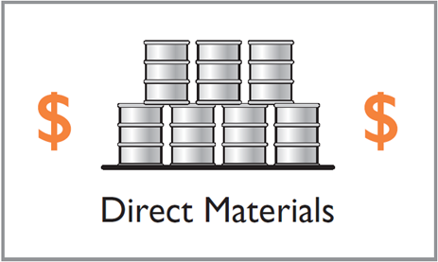
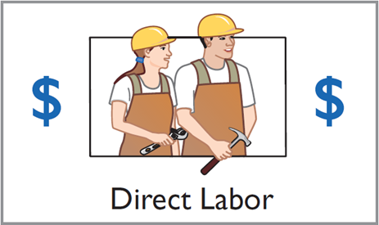
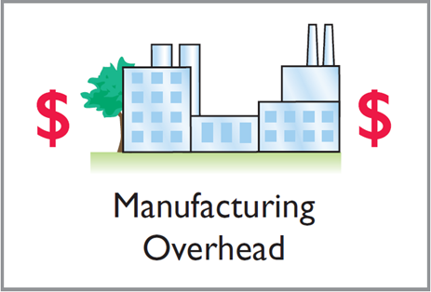
Manufacturing Costs (1 of 5)
Activities and processes that convert raw materials into finished goods.

Slide 13
Manufacturing Costs (2 of 5)
Direct Materials
Raw Materials
Basic materials and parts used in manufacturing process
Raw materials that can be physically and directly associated with finished are direct materials

Slide 14
Manufacturing Costs (3 of 5)
Indirect Materials have one of two characteristics
Not physically part of finished product
Are impractical to trace to finished product because their association with finished product is too small in terms of cost
Considered part of manufacturing overhead

Slide 15

Manufacturing Costs (4 of 5)
Direct Labor
Work of factory employees that can be physically and directly associated with converting raw materials into finished goods.
Indirect Labor
Work of factory employees that has no association with finished product or
which is impractical to trace costs to goods produced.

Slide 16

Manufacturing Costs (5 of 5)
Manufacturing Overhead
Costs indirectly associated with manufacturing the finished product
All manufacturing costs except direct materials and direct labor
Also called factory overhead and indirect manufacturing costs

Slide 17
Product Versus Period Costs (1 of 3)
Product Costs
Components:
Direct materials
Direct labor
Manufacturing overhead
Costs that are an integral part of producing product
Recorded in “inventory” account
Not an expense (C O G S) until goods are sold

Slide 18
Product Versus Period Costs (2 of 3)
Period Costs
Charged to expense as incurred
Non-manufacturing costs
Includes all selling and administrative expenses

Slide 19
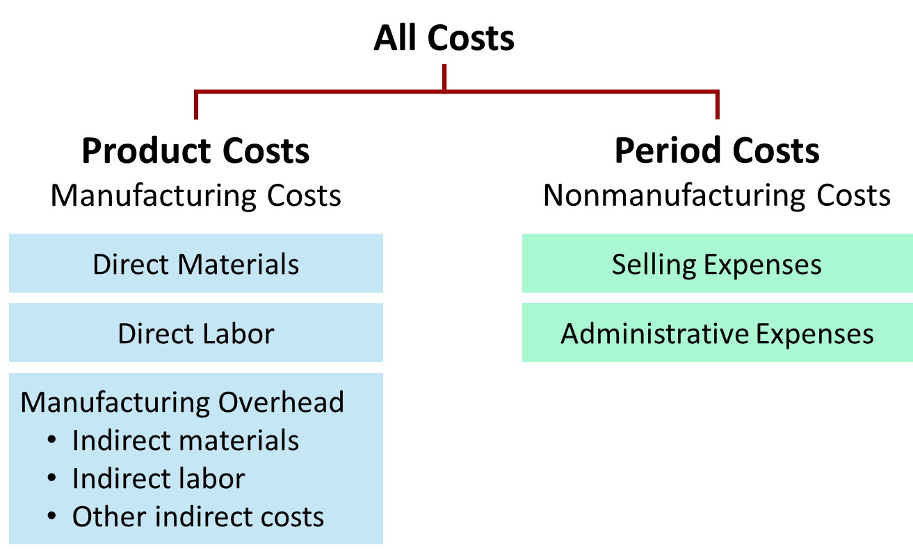
Product Versus Period Costs (3 of 3)

Slide 20
Illustration of Cost Concepts (1 of 3)
Illustration: Suppose you started your own snowboard factory, Terrain Park Boards. Here are some of the costs that your snowboard factory would incur. Assign the following costs:
Product Costs
Cost Item | Direct Materials | Direct Labor | Manufacturing Overhead | Period Costs
Material cost ($30 per board) | X
Labor costs ($40 per board) |  | X
Depreciation on factory equipment ($25,000 per year) |  |  | X
Property taxes on factory building ($6,000 per year) |  |  | X

Slide 21
Illustration of Cost Concepts (2 of 3)
Product Costs
Cost Item | Direct Materials | Direct Labor | Manufacturing Overhead | Period Costs
Advertising costs ($60,000 per year) |  |  |  | X
Sales commissions ($20 per board) |  |  |  | X
Maintenance salaries (factory facilities, $45,000 per year) |  |  | X
Salary of plant manager ($70,000 per year) |  |  | X
Cost of shipping boards ($8 per board) |  |  |  | X

Slide 22
Illustration of Cost Concepts (3 of 3)
If Terrain Park Boards produces 10,000 snowboards the first year, what would be the total manufacturing costs?
Cost Number and Item | Manufacturing Cost
Material cost ($30 × 10,000) | $300,000
Labor cost ($40 × 10,000) | 400,000
Depreciation on factory equipment | 25,000
Property taxes on factory building | 6,000
Maintenance salaries (factory facilities) | 45,000
Salary of plant manager | 70,000
Total manufacturing costs | $846,000

Slide 23
Do It! 2: Managerial Cost Concepts
A bicycle company has these costs: tires, salaries of employees who put tires on the wheels, factory depreciation, advertising expenditures, lubricants, spokes, salary of factory manager, salary of accountant, handlebars, and salaries of factory maintenance employees. Classify each cost as direct materials, direct labor, overhead, or a period cost.
Direct Materials
Direct Labor
Overhead
Tires
Salaries of employees who put tires on the wheels
Factory depreciation
Spokes
Factory lubricants
Handlebars
Factory manager salary
Factory maintenance employees salary
Advertising expenditures and salary of accountant are period costs.

Slide 24
Manufacturing Costs in Financial Statements
Income Statement
Under a periodic inventory system, the income statements of a merchandiser and a manufacturer differ in the cost of goods sold section.

Slide 25
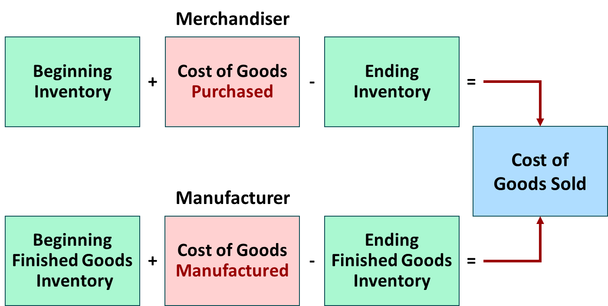
Income Statement (1 of 2)

Slide 26
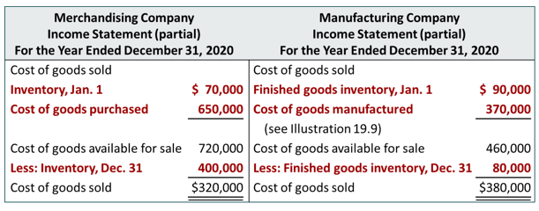
Income Statement (2 of 2)
Cost of goods sold sections of merchandising and manufacturing income statements

Slide 27
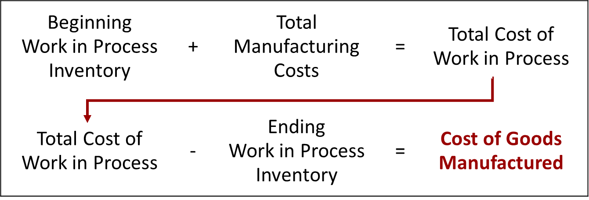
Cost of Goods Manufactured (1 of 2)
Total Manufacturing Costs – sum of direct material costs, direct labor costs, and manufacturing overhead in the current year.
Total Work in Process – (1) cost of beginning work in process and (2) total manufacturing costs for the current period.

Slide 28
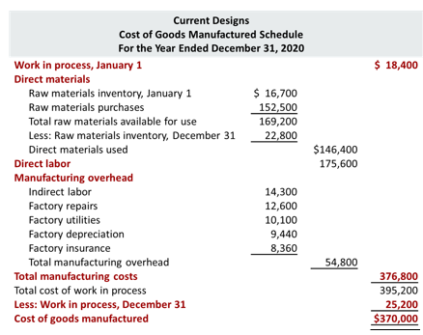
Cost of Goods Manufactured (2 of 2)

Slide 29
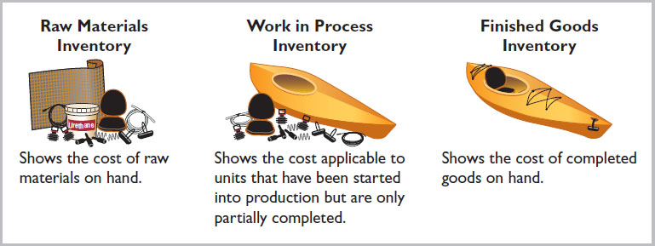
Balance Sheet (1 of 2)
The balance sheet for a merchandising company shows just one category of inventory.

Slide 30
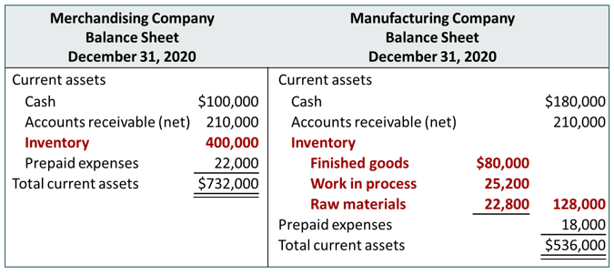
Balance Sheet (2 of 2)

Slide 31
Do It! 3: Cost of Goods Manufactured (1 of 2)
The following information is available for Keystone Company.
 |  | March 1 | March 31
Raw materials inventory |  | $12,000 | $10,000
Work in process inventory |  | 2,500 | 4,000
Materials purchased in March | $ 90,000
Direct labor in March | 75,000
Manufacturing overhead in March | 220,000
Prepare the cost of goods manufactured schedule for the month of March 2020.

Slide 32
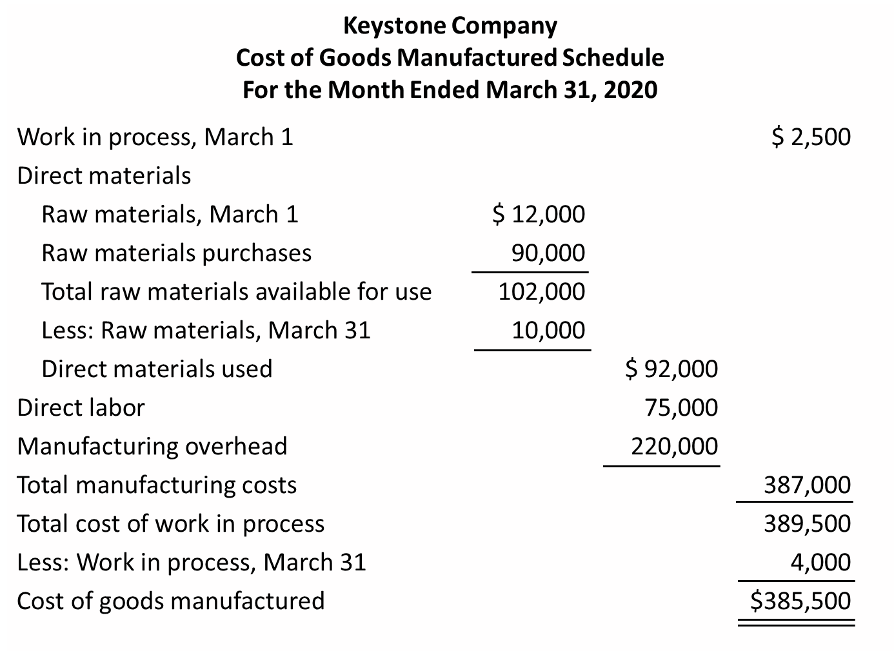
Do It! 3: Cost of Goods Manufactured (2 of 2)

Slide 33
Managerial Accounting Today
Service Industries
Much of U.S. economy has shifted toward an emphasis on services
Over 50% of U.S. workers are now employed by service companies
Most techniques learned for manufacturing firms are applicable to service companies

Slide 34
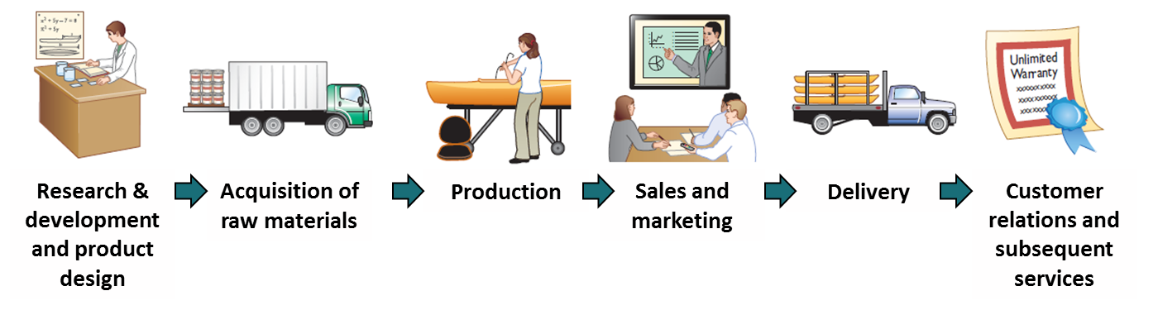
Focus on the Value Chain (1 of 4)
Refers to all business processes associated with providing a product or service
For a manufacturing firm these include the following:

Slide 35
Focus on the Value Chain (2 of 4)
Just-In-Time (J I T) Inventory Method
System in which goods are manufactured or purchased just in time for sale
Total Quality Management (T Q M)
Reduce defects in finished products, with goal of zero defects

Slide 36
Focus on the Value Chain (3 of 4)
Theory of Constraints
Constraints (“bottlenecks”) limit company’s potential profitability
A specific approach to identify and manage these constraints in order to achieve company goals
Enterprise Resource Planning (E R P)
Software programs designed to manage all major business processes

Slide 37
Focus on the Value Chain (4 of 4)
Activity-Based Costing (A B C)
Allocates overhead based on use of activities
Results in more accurate product costing and contribute to increased efficiency in the value chain

Slide 38
Balanced Scorecard
Evaluates operations in an integrated fashion
Uses both financial and non-financial measures
Links performance to overall company objectives

Slide 39
Business Ethics (1 of 2)
All employees are expected to act ethically
Many organizations have codes of business ethics
Creating Proper Incentives
Systems and controls sometimes create incentives for managers to take unethical actions
Controls need to be effective and realistic

Slide 40
Business Ethics (2 of 2)
Code of Ethical Standards
Sarbanes-Oxley Act (S O X)
Clarifies management’s responsibilities
Requires certifications by C E O and C F O
Selection criteria for Board of Directors and Audit Committee
Substantially increased penalties for misconduct

Slide 41
Corporate Social Responsibility
Considers a company’s efforts to employ sustainable business practices
Sometimes referred to as triple bottom line because it evaluates a company’s performance with regard to people, planet, and profit
Recent reports indicate that over 50% of the 500 largest U.S. companies provide sustainability reports

Slide 42
Do It! 4: Trends in Managerial Accounting (1 of 6)
Match the descriptions that follow with the corresponding terms.
______ All activities associated with providing a product or performing service.
______ A method of allocating overhead based on each product’s use of activities in making the product.
______ Systems implemented to reduce defects in finished products with the goal of achieving zero defects.
Terms:
a. Activity-based costing
b. Balanced scorecard
c. Corporate social responsibility
d. Just-in-time (J I T) inventory
e. Total quality management (T Q M)
f. Statement of Ethical Professional Practice
g. Value chain

Slide 43
Do It! 4: Trends in Managerial Accounting (2 of 6)
Match the descriptions that follow with the corresponding terms.
___g___ All activities associated with providing a product or performing service.
___a___ A method of allocating overhead based on each product’s use of activities in making the product.
___e___ Systems implemented to reduce defects in finished products with the goal of achieving zero defects.
Terms:
a. Activity-based costing
b. Balanced scorecard
c. Corporate social responsibility
d. Just-in-time (J I T) inventory
e. Total quality management (T Q M)
f. Statement of Ethical Professional Practice
g. Value chain

Slide 44
Do It! 4: Trends in Managerial Accounting (3 of 6)
Match the descriptions that follow with the corresponding terms.
______ A performance-measurement approach that uses both financial and nonfinancial measures, tied to company objectives, to evaluate a company’s operations in an integrated fashion.
______ Inventory system in which goods are manufactured or purchased just as they are needed for use.
Terms:
a. Activity-based costing
b. Balanced scorecard
c. Corporate social responsibility
d. Just-in-time (J I T) inventory
e. Total quality management (T Q M)
f. Statement of Ethical Professional Practice
g. Value chain

Slide 45
Do It! 4: Trends in Managerial Accounting (4 of 6)
Match the descriptions that follow with the corresponding terms.
___b___ A performance-measurement approach that uses both financial and nonfinancial measures, tied to company objectives, to evaluate a company’s operations in an integrated fashion.
___d___ Inventory system in which goods are manufactured or purchased just as they are needed for use.
Terms:
a. Activity-based costing
b. Balanced scorecard
c. Corporate social responsibility
d. Just-in-time (J I T) inventory
e. Total quality management (T Q M)
f. Statement of Ethical Professional Practice
g. Value chain

Slide 46
Do It! 4: Trends in Managerial Accounting (5 of 6)
Match the descriptions that follow with the corresponding terms.
______ A company’s efforts to employ sustainable business practices with regards to its employees, society, and the environment.
______ A code of ethical standards developed by the Institute of Management Accountants.
Terms:
a. Activity-based costing
b. Balanced scorecard
c. Corporate social responsibility
d. Just-in-time (J I T) inventory
e. Total quality management (T Q M)
f. Statement of Ethical Professional Practice
g. Value chain

Slide 47
Do It! 4: Trends in Managerial Accounting (6 of 6)
Match the descriptions that follow with the corresponding terms.
___c___ A company’s efforts to employ sustainable business practices with regards to its employees, society, and the environment.
___f___ A code of ethical standards developed by the Institute of Management Accountants.
Terms:
a. Activity-based costing
b. Balanced scorecard
c. Corporate social responsibility
d. Just-in-time (J I T) inventory
e. Total quality management (T Q M)
f. Statement of Ethical Professional Practice
g. Value chain

Slide 48
Copyright
Copyright © 2018 John Wiley & Sons, Inc.
All rights reserved. Reproduction or translation of this work beyond that permitted in Section 117 of the 19 76 United States Act without the express written permission of the copyright owner is unlawful. Request for further information should be addressed to the Permissions Department, John Wiley & Sons, Inc. The purchaser may make back-up copies for his/her own use only and not for distribution or resale. The Publisher assumes no responsibility for errors, omissions, or damages, caused by the use of these programs or from the use of the information contained herein.

